Slide 1
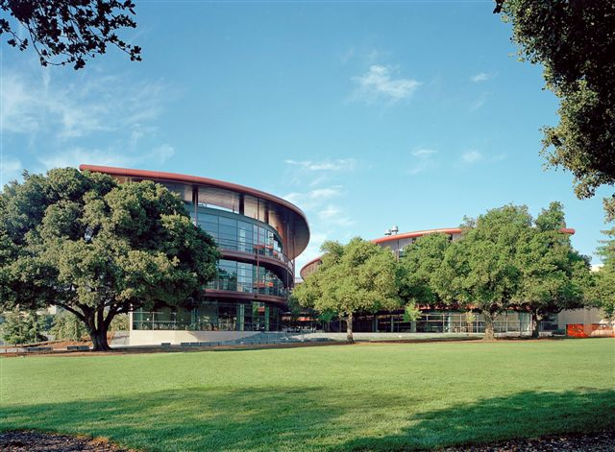
Working with genomics data
Andrew Gentles
Medicine (BMIR) and Biomedical Data Sciences

Slide 2
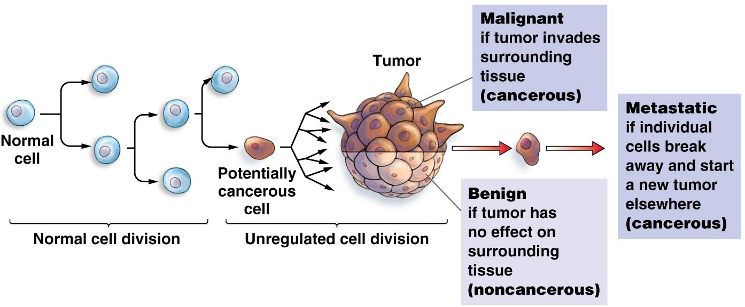
How do tumors develop?

Slide 3
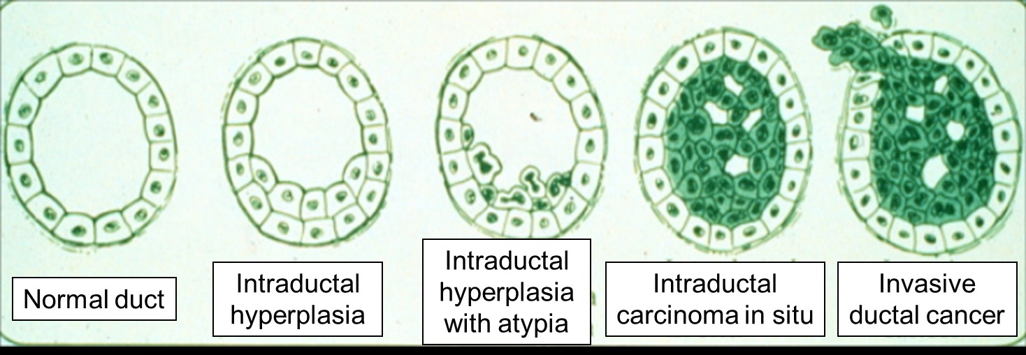
Breast Cancer Development
5 year survival:
Stage 1: 95-100%
Stage 2: 86%
Stage 3: 57%
Stage 4: 20%
BUMC.org

Slide 4
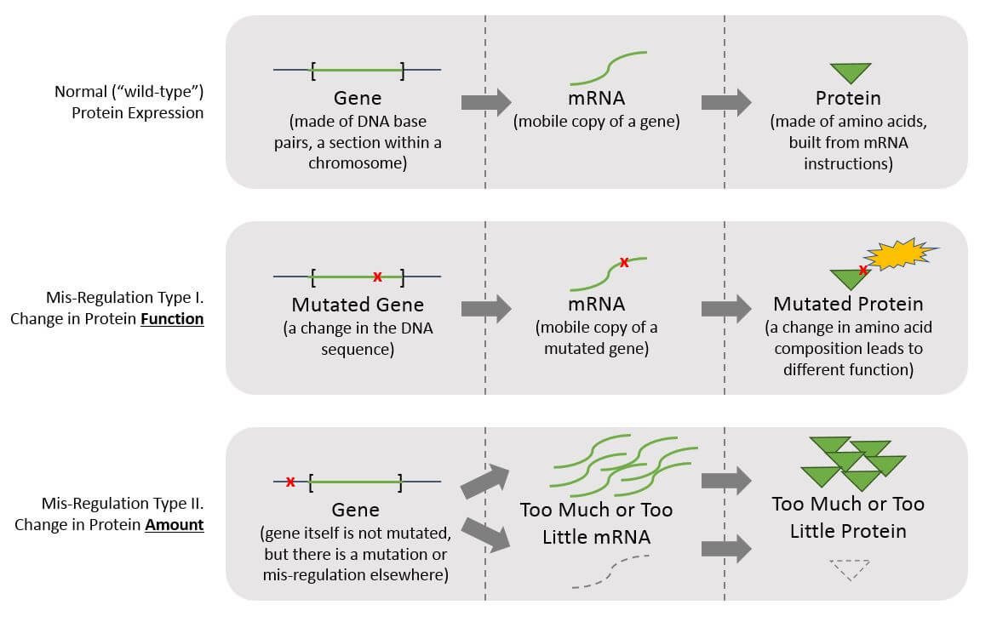
Biomarker types
https://bluematterconsulting.com/precision-medicine-part-i-molecular-testing/

Slide 7
Some selected topics in systems biology
Brief review of genomics data types
Reconstructing regulatory networks
Transcriptional networks
Connecting genomics with outcomes (survival)
Dissecting tissues (e.g. tumors) at single cell resolution

Slide 8
Cancer systems biology – one definition
Cancer systems biology adopts a holistic view of cancer aimed at integrating its many biological scales, including genetics, signaling networks, epigenetics, cellular behavior, histology, (pre)clinical manifestations and epidemiology.
https://en.wikipedia.org/wiki/Cancer_systems_biology

Slide 9
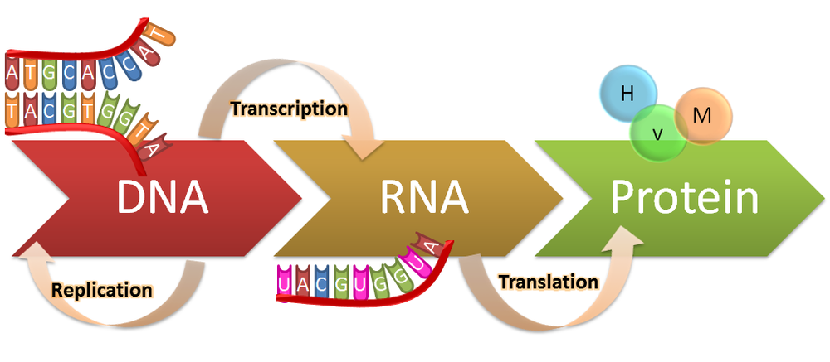
Central dogma of molecular biology

Slide 10
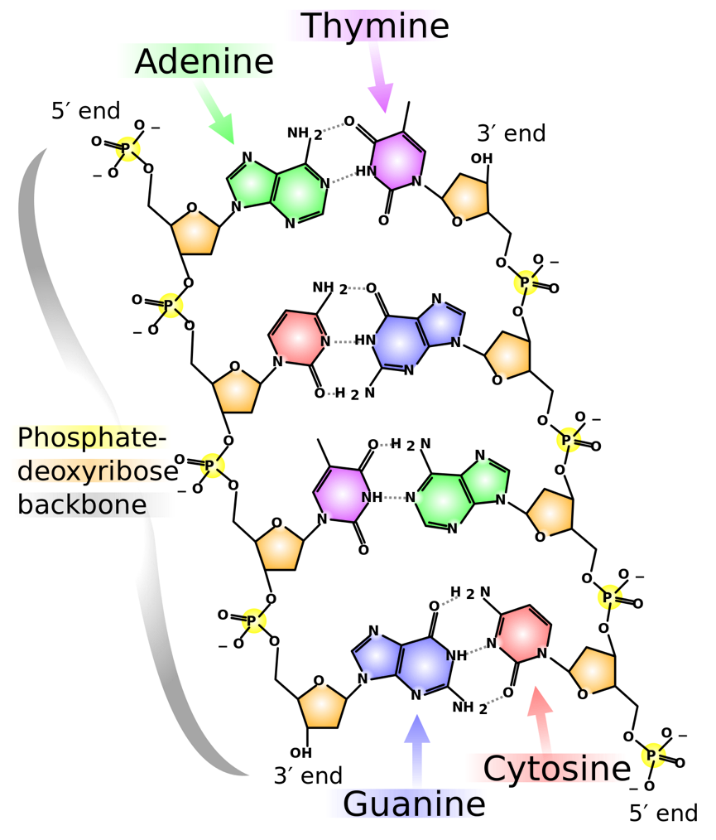
DNA and RNA complementarity
Notes:
This forms the basis for many molecular biology techniques, which make a large number of assays possible for DNA and RNA that are not possible for e.g. proteins

Slide 11
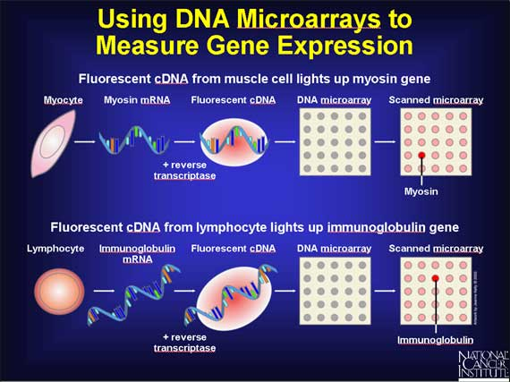

Slide 12
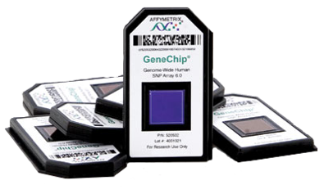
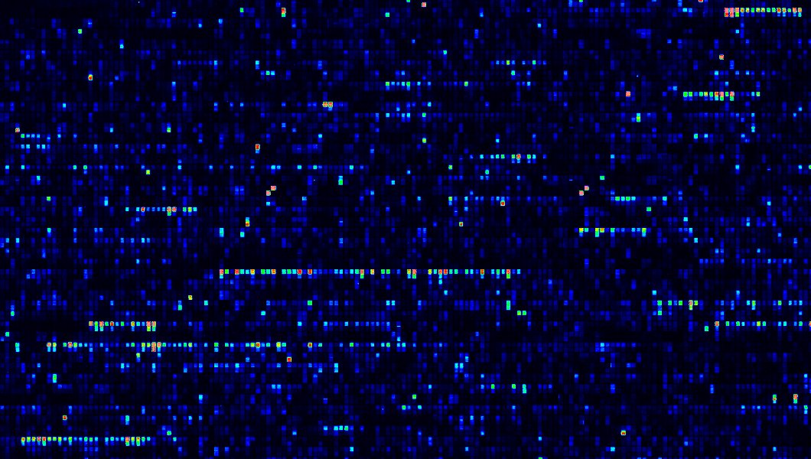
We can assess activity of thousands of genes in a sample
If a gene is expressed, it will bind to its complementary probe on the array
http://learn.genetics.utah.edu/content/labs/microarray/

Slide 13
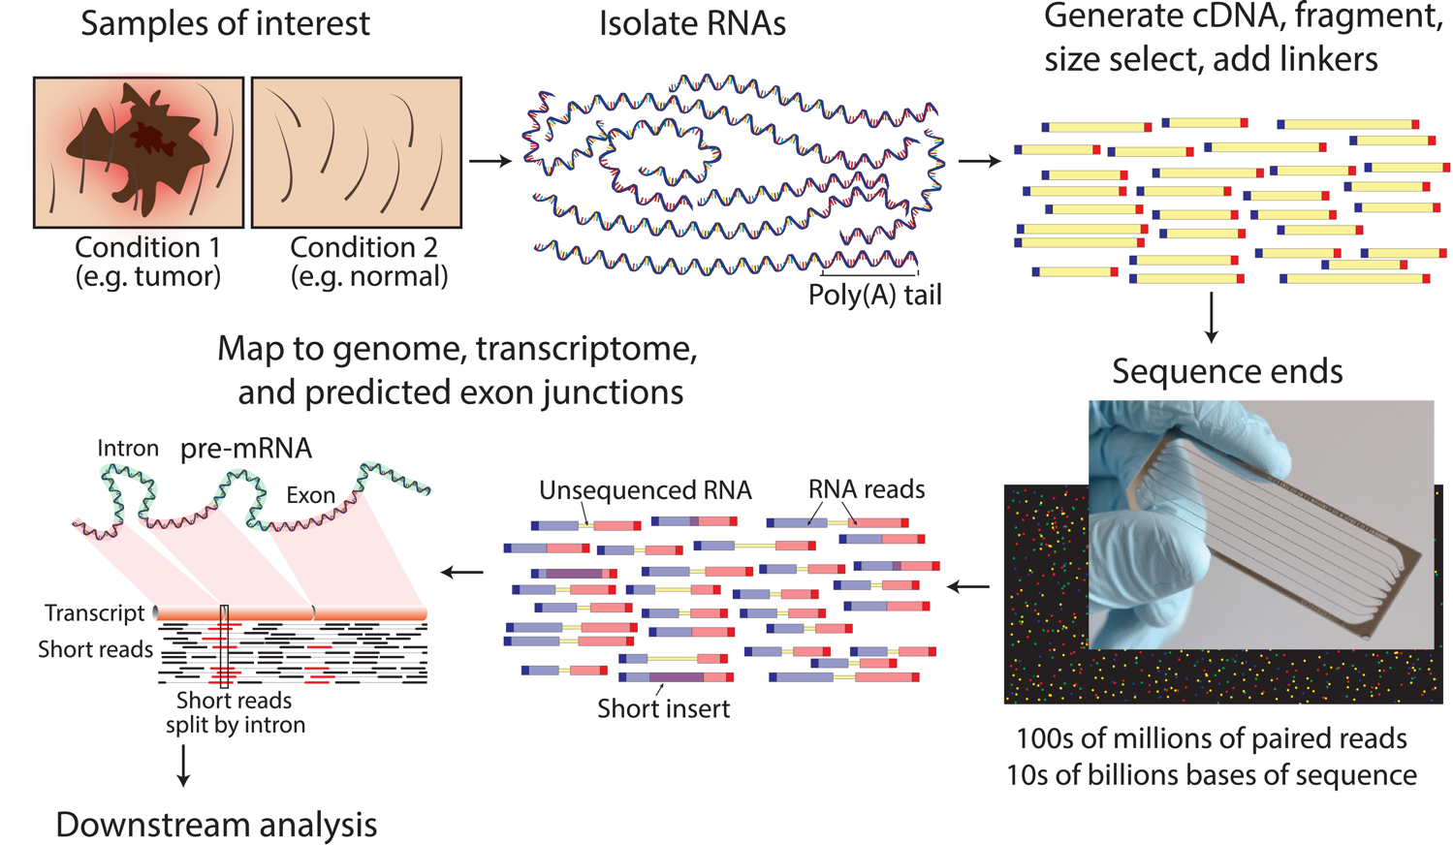
Next generation sequencing
https://en.wikipedia.org/wiki/RNA-Seq

Slide 14
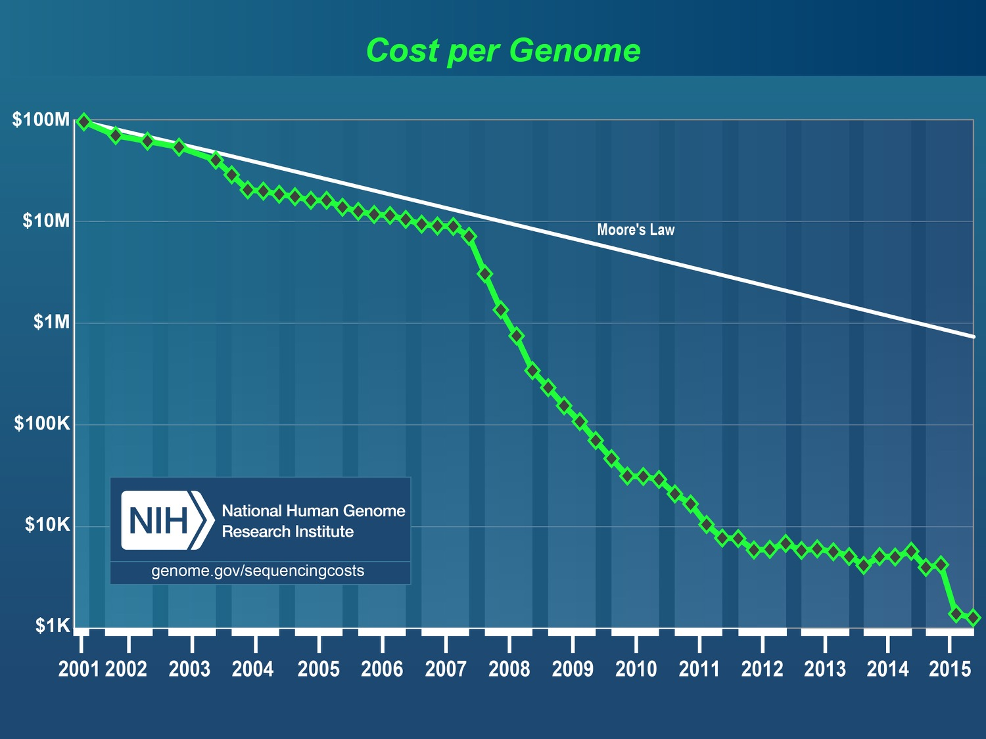
Notes:
In 1990, Congress established funding for the Human Genome Project and set a target completion date of 2005. Although estimates suggested that the project would cost a total of $3 billion over this period, the project ended up costing less than expected, about $2.7 billion in FY 1991 dollars. https://www.genome.gov/11006943/human-genome-project-completion-frequently-asked-questions/

Slide 15
Growth of gene expression omnibus at NCBI
https://plot.ly/~sambucas/34/the-growth-of-the-gene-expression-omnibus/

Slide 16
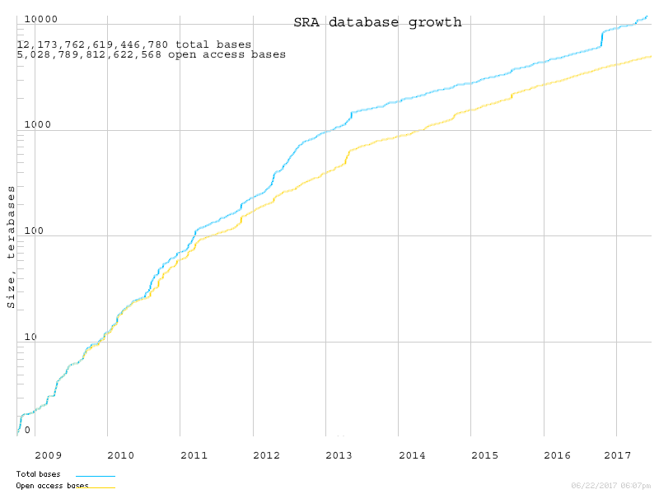
Sequence data are accumulating rapidly

Slide 17
Raw data – ballpark sizes
Data type | Typical size ~
DNA microarray (Affymetrix cell file) | 10 Mb
TCGA histology slide scan (SVS) | 300 Mb
Exome sequence fastq (100X) | 10 Gb
Single RNA-seq experiment | 10 Gb
Single whole genome | 600 Gb
Complete TCGA dataset (11,000 tumors) | 50 Pb (50,000 Tb)

Slide 18
Sequencing is cheap(ish)
What about the analysis ?
Storage
Compute costs
Interpretation

Slide 19
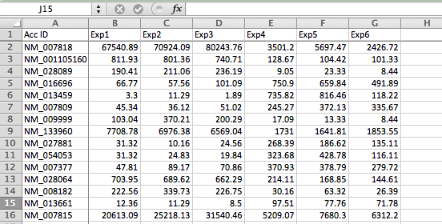
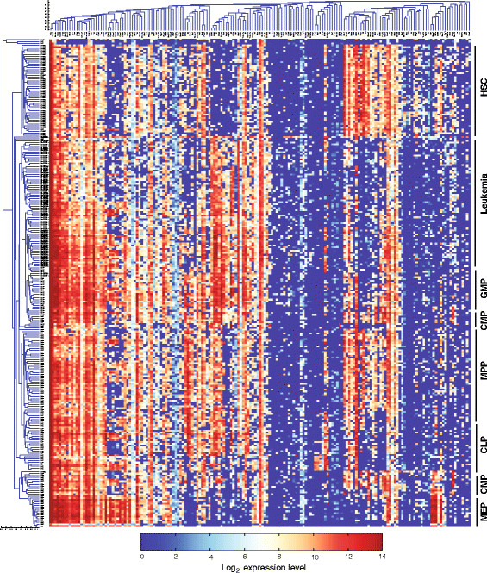
Endpoint is moderately large scale data
10-1000’s columns (samples)
10,000’s-100,000’s rows (genes, transcripts)

Slide 20
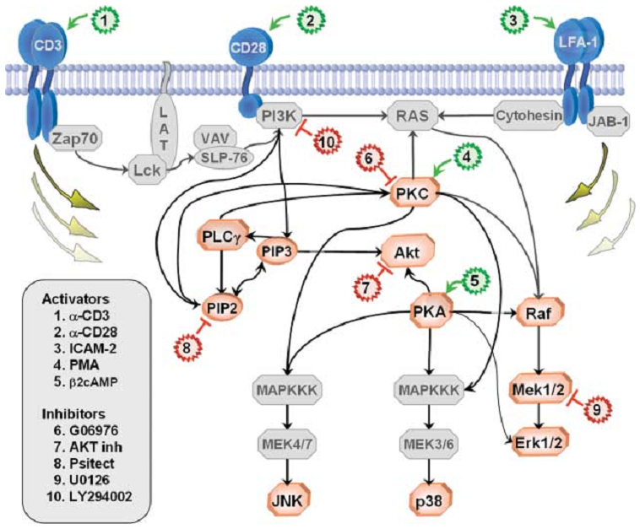
Network types
Protein-protein
Protein-DNA
miRNA-RNA
Transcriptional (expression) networks
Signaling networks
Sachs et al. http://www.sciencemag.org/content/308/5721/523.full

Slide 21
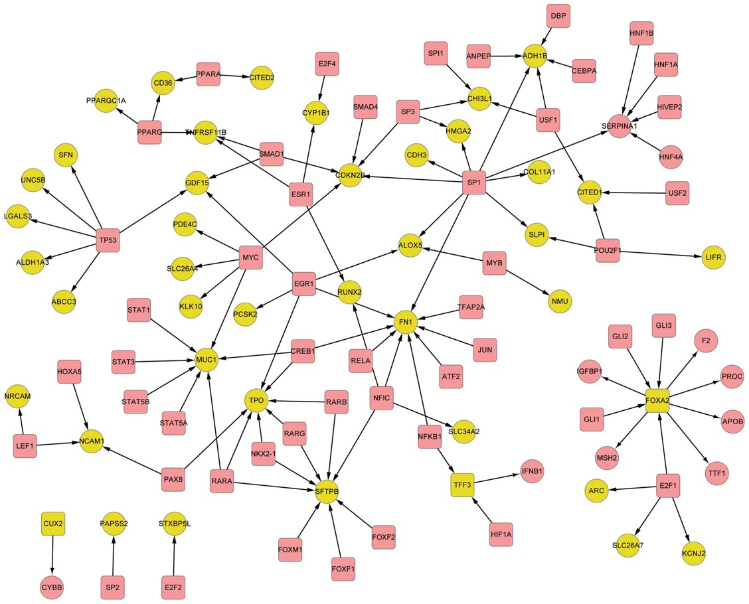
Gene regulatory networks
They are a “flowchart” of interactions, not a detailed model

Slide 22
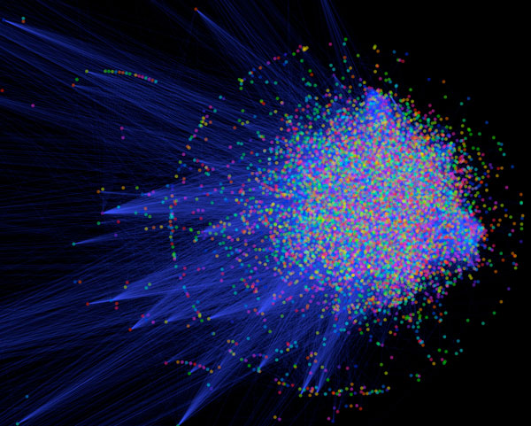

Hard to interpret!

Slide 23
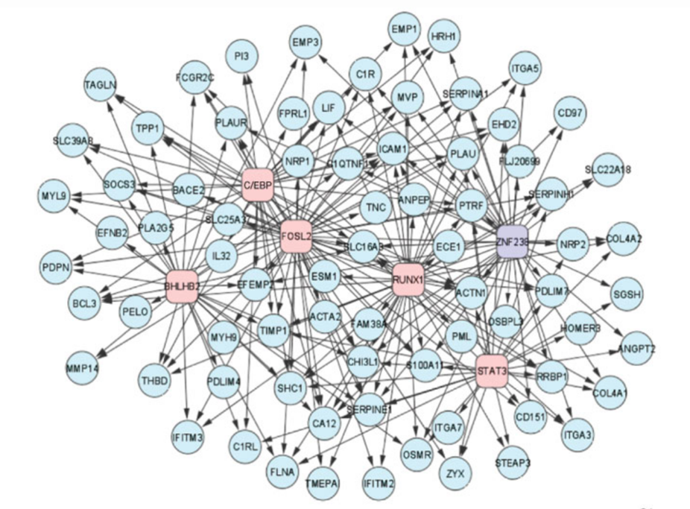
Transcriptional regulatory networks
Imperfect but powerful representation of the system
Example: Glioblastoma subtypes
Hairball -> targets of transcription factors -> which are differentially expressed between GBM types
Carro et al. Nature 2009
Actual causality is hard from observational data

Slide 24
How do these networks compare in size to ones in the physical world
E.g. electrical system, telecommunications
What sort of qualitative differences are there?
Do cats or dogs produce worse hairballs?

Slide 25
Associating survival with expression levels
Variable | Patient1 | Patient2 |  | Patient4 | Patient5 | Patient6 | Patient7 | …
Time | 12 | 3 |  | 8 | 35 | 14 | 22 | …
Status | 1 | 1 |  | 1 | 0 | 0 | 1 | …
Gene1 | 1.45 | 0.15 |  | -0.59 | -1.88 | -0.83 | -0.26 | …
Gene2 | 0.94 | -0.35 |  | 2.66 | -0.23 | 2.09 | -0.13 | …
Gene3 | 0.91 | -0.32 |  | -0.82 | -0.35 | 0.86 | 0.32 | …
…
We could look at a fixed time e.g. alive/dead at 5 years – but this throws away information
Survival often assessed by hazard ratio – the increase in risk of an event (e.g. death) for each unit increase in some variable (e.g. age, expression level of a gene)
Extra detail:
H(t,x_{i}) = h₀(t) x exp{b_{i}x_{i}}
X_{i} = expression of gene i at sample collection

Slide 26
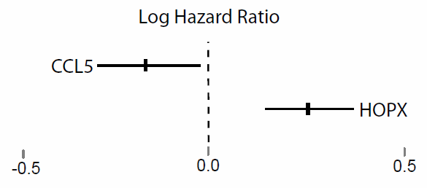
Gene expression ~ survival
Z=-2.2
p=0.02
Z=+4.5
p=4e-6
“Good” genes
“Bad” genes

Slide 27
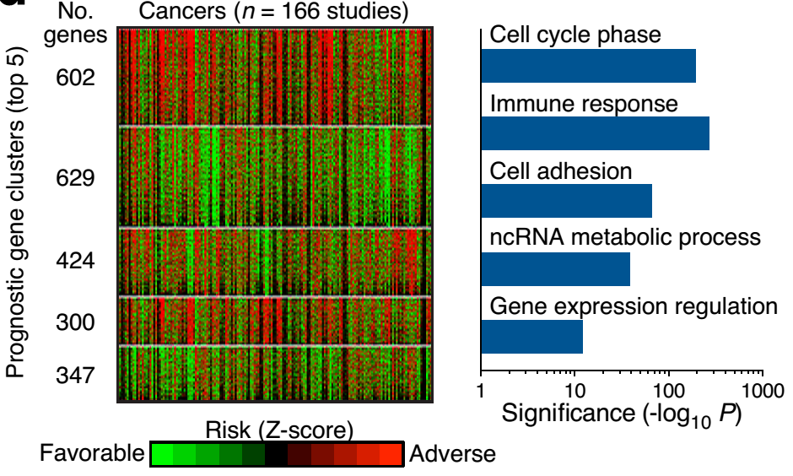
Clustering of outcome matrix -> biological processes
http://precog.stanford.edu

Slide 28
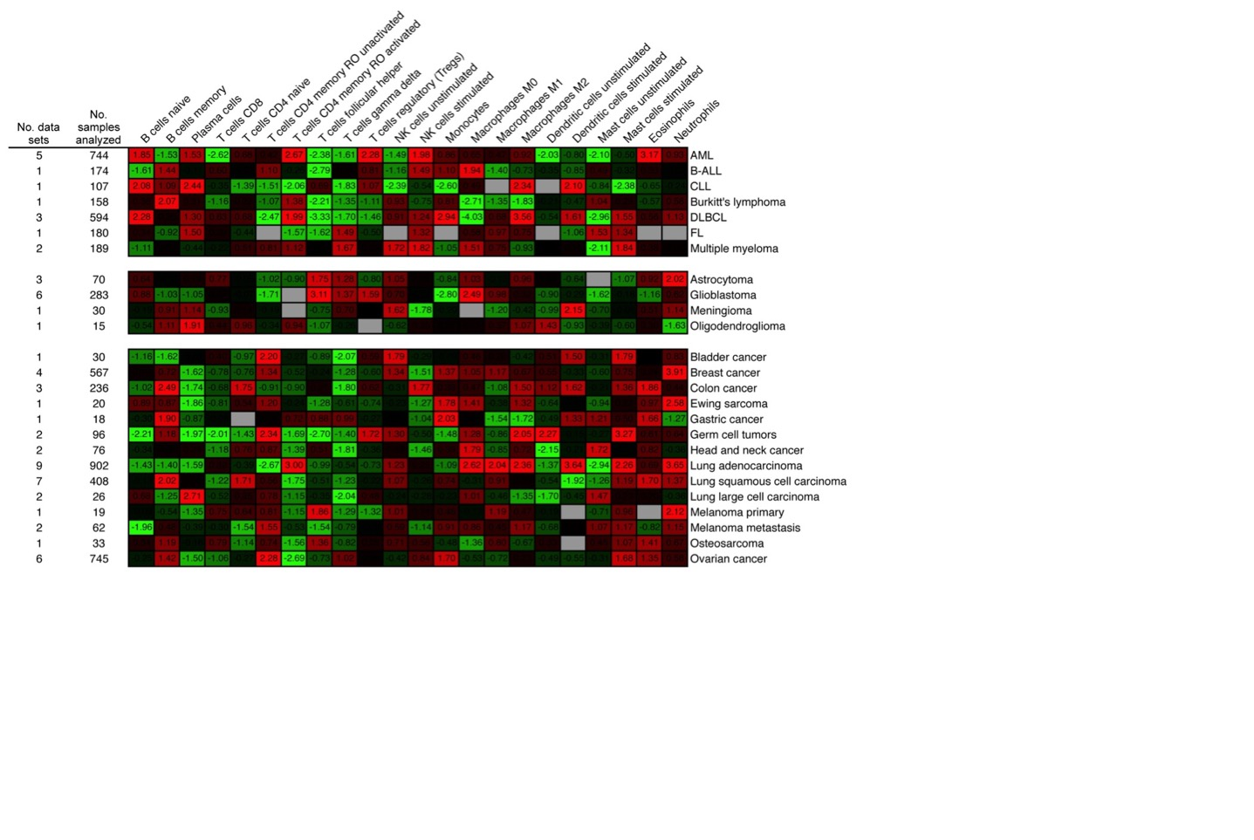
Prognostic influence of immune infiltrates

Slide 29





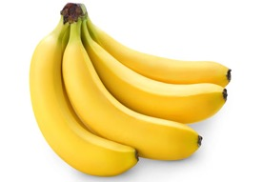
Heterogeneity of tissues (and tumors)
Bulk RNA-seq
Single-cell RNA-seq
Profiling of sorted populations
Notes:
We took an intermediate strategy between bulk RNA-seq and single-cell RNA-seq. Latter is not yet affordable for many samples.

Slide 30
Can you tell what’s in a smoothie by taste?
How many different flavours?
How small a proportion of the mix?
Is it easier to detect presence or absence ?

Slide 31
Averaging across cell types
Trapnell et al. 2015 Genome Res. 25: 1491-1498
Notes:
Which is which

Slide 32
Why single cell?
Trapnell et al. 2015 Genome Res. 25: 1491-1498
Simpson’s paradox

Slide 33
Single cell RNA-seq approaches
Papalexi & Satuja Nat Rev Imm 2018

Slide 34
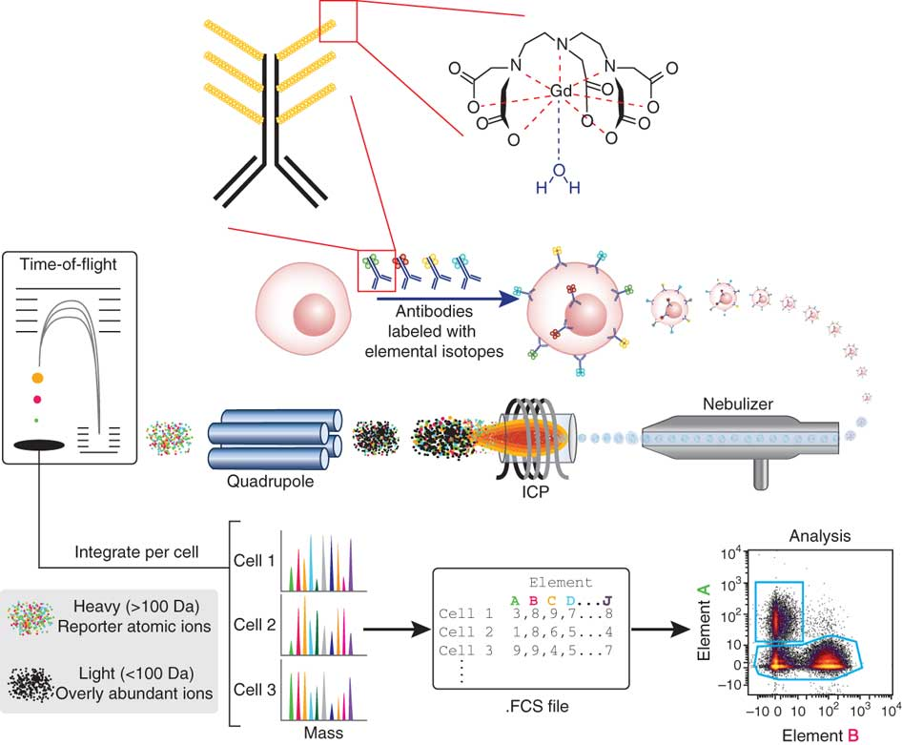
Mass cytometry – single cell proteomics

Slide 35
Single cell RNA-seq vs CyTOF
Advantages and disadvantages to both
scRNA-seq
1000s of genes X 1000s of cells
Very sparse (up to 90% missing)
CyTOF
~40 proteins X up to millions of cells
“complete” matrix
Potential for spatial info (CODEX)

Slide 36
Why would you choose RNA-seq vs CyTOF
(or among different platforms)
Hint: breadth vs depth
Which of these might be useful in the projects you are involved with this summer?

Slide 37
Tissues form hierarchies
Hamey et al PNAS 2017

Slide 38
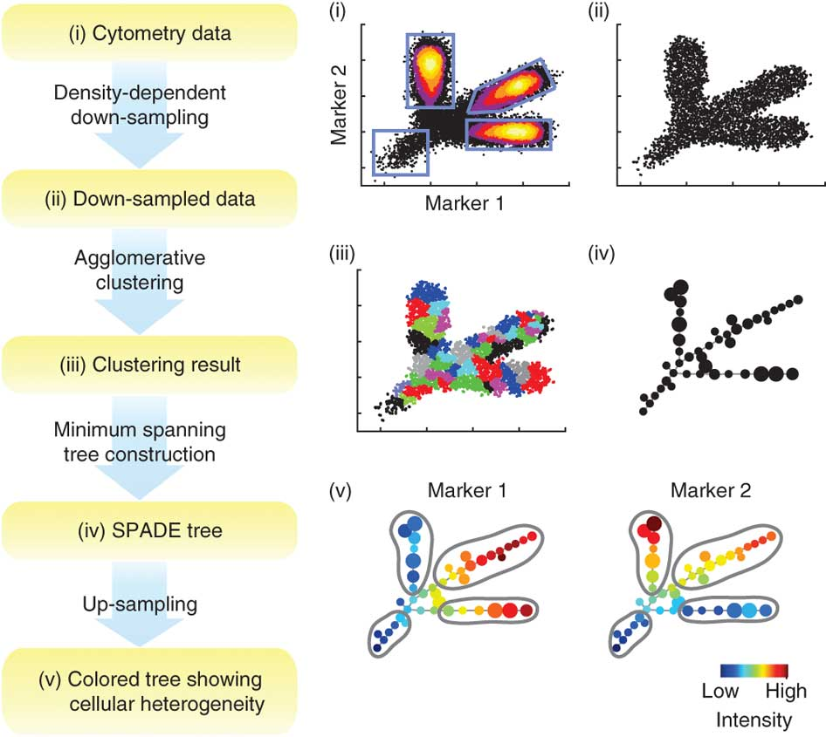
SPADE analysis
Qiu et al
Nature Methods 2011

Slide 39
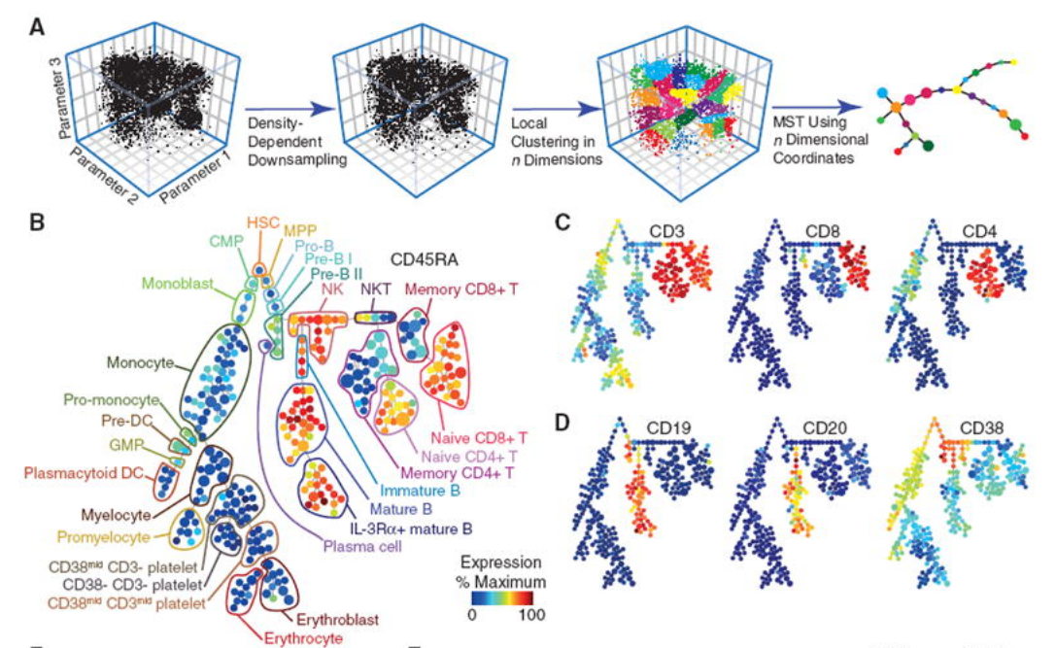
SPADE analysis of single-cell blood data
Bendall et al Science 2011

Slide 40
Summing up
Many high-throughput technologies generating huge amounts of data
Skew towards RNA/DNA, because of sequence complementarity
Key aims
Reconstruct networks underlying/driving disease
Identify biomarkers for prognosis, treatment etc
Computational and statistical methods are key

Slide 41
PSON cell line datasets
Gene expression from various cell lines from various cancer types (breast, colon, etc)
Physical measures on them:
Speed they move
Distance they move in certain time
Measured on various types of surface/medium
https://physics.cancer.gov/bioresources/

Slide 42
Activity for next time
Inspect gene expression matrix and sample info for cell lines
Connect the two together based on common identifiers
Look at relationship between expression of genes and how fast cells can move
Identify genes that might be related to breast cancer metastasis

